Slide 1
Objectives
In this chapter, you will learn to:
  Identify security threats to enterprise networks
  Describe methods to mitigate security threats to enterprise networks
  Configure basic router security
  Disable unused router services and interfaces
  Use the Cisco SDM one-step lockdown feature
  Manage files and software images with the Cisco IOS Integrated File System (IFS)

Slide 2
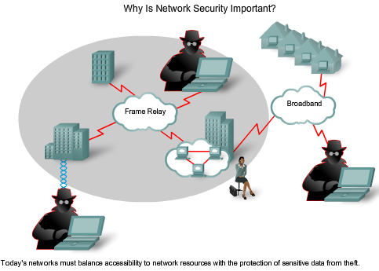
Why is Network Security Important?
Computer networks have grown in both size and importance in a very short time.
  If the security of the network is compromised, there could be serious consequences, such as loss of privacy, theft of information, and even legal liability.
In this chapter You will learn about
  different types of threats,
  the development of organizational security policies, mitigation techniques,
  Cisco software tools to help secure networks.
  managing Cisco IOS software images.
    Although this may not seem like a security issue, Cisco software images and configurations can be deleted. Devices compromised in this way pose security risks.
Notes:
Use graphic 1.1.1.1
Use graphic 1.1.1.3

Slide 3
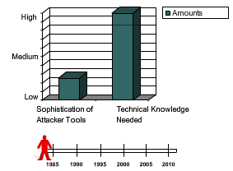
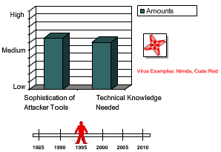
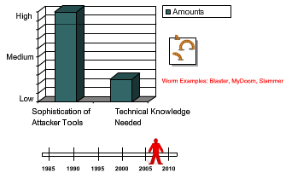
The Increasing Threat to Security
Over the years, tools and methods have evolved.
  In 1985 an attacker had to have sophisticated computer, knowledge to make tools and basic attacks.
  As time went on, and attackers' tools improved, attackers no longer required the same level knowledge.
Some of the most common terms are as follows:
  White hat - An individual who looks for vulnerabilities in systems and reports these so that they can be fixed.
  Black hat - An individuals who use their knowledge to break into systems that they are not authorized to use.
  Hacker - An individual that attempts to gain unauthorized access to network with malicious intent.
  Cracker - Someone who tries to gain unauthorized access to network resources with malicious intent.
  Phreaker - Individual who manipulates phone network, through a payphone, to make free long distance calls.
  Spammer - An individual who sends large quantities of unsolicited e-mail messages.
  Phisher - Uses e-mail or other means to trick others into providing information, such as credit card numbers.
Notes:
Use graphic 1.1.1.1
Use graphic 1.1.1.3

Slide 4
Think Like a Attacker
Many attackers use this seven-step process to gain information and state an attack.
  Step 1. Perform footprint analysis (reconnaissance).
    Company webpage can lead to information, such as IP addresses of servers.
  Step 2. Enumerate information.
    An attacker can expand on the footprint by monitoring network traffic with a packet sniffer such as Wireshark, finding information such as version of servers.
  Step 3. Manipulate users to gain access.
    Sometimes employees choose passwords that are easily crackable.
  Step 4. Escalate privileges.
    After attackers gain basic access, they use their skills to increase privileges.
  Step 5. Gather additional passwords and secrets.
    With improved privileges, attackers gain access to sensitive information.
  Step 6. Install backdoors.
    Backdoors provide the attacker to enter the system without being detected.
  Step 7. Leverage the compromised system.
    After a system is compromised, attacker uses it to attack others in the network.
Notes:
Use graphic 1.1.1.1
Use graphic 1.1.1.3

Slide 5
Types of Computer Crime
These are the most commonly reported acts of computer crime that have network security implications. In certain countries, some of these activities may not be a crime, but are still a problem.
  Insider abuse of network access
  Virus
  Mobile device theft
  Phishing where an organization is fraudulently represented as the sender
  Instant messaging misuse
  Denial of service
  Unauthorized access to information
  Bots within the organization
  Theft of customer or employee data
  Abuse of wireless network
  System penetration
  Financial fraud
  Password sniffing
  Key logging
  Website defacement
  Misuse of a public web application
  Theft of proprietary information
  Exploiting the DNS server of an organization
  Telecom fraud
  Sabotage
Notes:
Use graphic 1.1.1.1
Use graphic 1.1.1.3

Slide 6
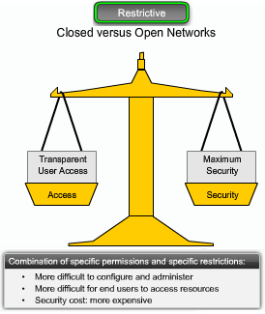
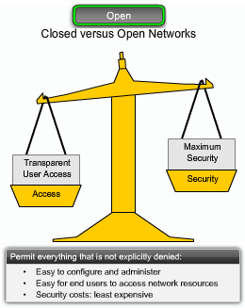
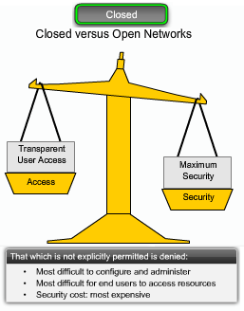
Open versus Closed Networks
The overall security challenge facing network administrators is balancing two important needs:
  keep networks open to support business requirements
  Protect private, personal, and business information.
Network security models is a progressive scale
  From open-any service is permitted unless it is expressly denied.
  To restrictive-services are denied by default unless deemed necessary.
  An extreme alternative for managing security is to completely close a network from the outside world.
    Because there is no outside connectivity, networks are considered safe from outside attacks.
    However, internal threats still exist. A closed network does little to prevent attacks from within the enterprise.
Notes:
Use graphic 1.1.1.1
Use graphic 1.1.1.3

Slide 7
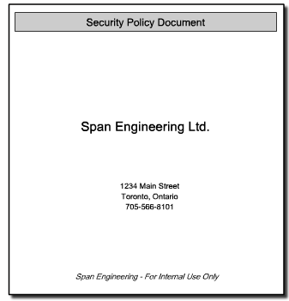
Developing a Security Policy
First step an organization should take to protect its data and a liability challenge is to develop a security policy.
A security policy meets these goals:
  Informs users, staff, and managers of their requirements for protecting information assets
  Specifies the mechanisms through which these requirements can be met
  Provides a baseline from which to acquire, configure, and audit computer systems for compliance
Assembling a security policy can be daunting. The ISO and IEC have published a security standard document called ISO/IEC 27002. The document consists of 12 sections:
  Risk assessment
  Security policy
  Organization of information security
  Asset management
  Human resources security
  Physical and environmental security
  Communications and operations management
  Access control
  Information systems acquisition, development, and maintenance
  Information security incident management
  Business continuity management
  Compliance
Notes:
Use graphic 1.1.1.1
Use graphic 1.1.1.3

Slide 8
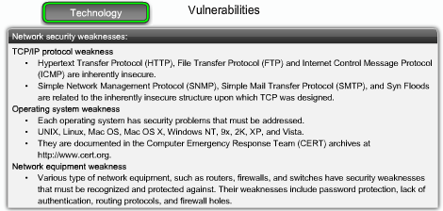
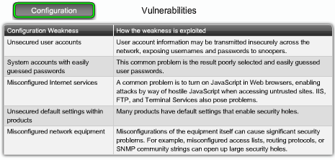
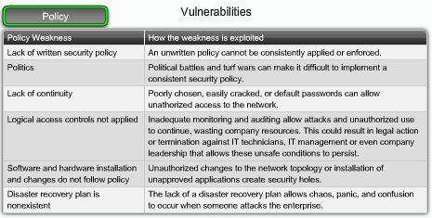
Vulnerabilities
When discussing network security, 3 factors are vulnerability, threat, attack.
  Vulnerability: it is the degree of weakness which is inherent in every network and device.
    Routers, switches, desktops, and servers.
  Threats: They are the people interested in taking advantage of each security weakness.
  Attack: The threats use a variety of tools, and programs to launch attacks against networks.
There are 3 primary vulnerabilities:
  Technological weaknesses
    Computer and network technologies have intrinsic security weaknesses. These include operating system, and network equipment.
  Configuration weaknesses
    Network administrators need to learn what the configuration weaknesses are.
  Security policy weaknesses
    Security risks to the network exist if users do not follow the security policy.
Notes:
Use graphic 1.1.1.1
Use graphic 1.1.1.3

Slide 9
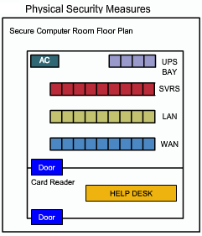
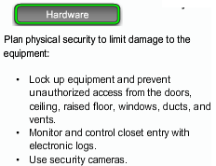
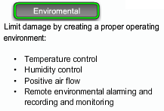
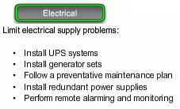
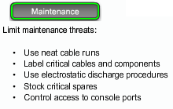
Threats to Physical Infrastructure
A less glamorous, but no less important, class of threat is the physical security of devices. An attacker can deny the use of network resources if those resources can be physically compromised.
The four classes of physical threats are:
  Hardware threats - Physical damage to servers, routers, switches, cabling plant, and workstations
  Environmental threats - Temperature extremes (too hot or too cold) or humidity extremes (too wet or too dry)
  Electrical threats - Voltage spikes, insufficient supply voltage (brownouts), unconditioned power (noise), and total power loss
  Maintenance threats - Poor handling of key electrical components (electrostatic discharge), lack of critical spare parts, poor cabling, and poor labeling
Here are some ways to mitigate physical threats:
Notes:
Use graphic 1.1.1.1
Use graphic 1.1.1.3

Slide 10
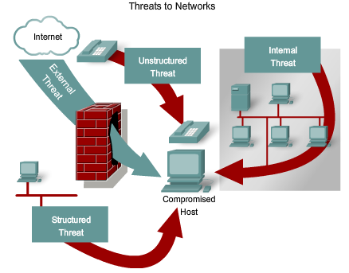
Threats to Networks
There are 4 primary classes of threats to networks:
Unstructured Threats
  Unstructured threats consist of mostly inexperienced individuals using easily available hacking tools, such as shell scripts and password crackers.
Structured Threats
  Structured threats come from individuals or groups that are more highly motivated and technically competent.
  They break into business computers to commit fraud, destroy or alter records, or simply to create havoc.
External Threats
  External threats can arise from individuals or organizations working outside of a company who do not have authorized access to the computer systems or network.
Internal Threats
  Internal threats occur when someone has authorized access to the network with either an account or physical access.
Notes:
Use graphic 1.1.1.1
Use graphic 1.1.1.3

Slide 11
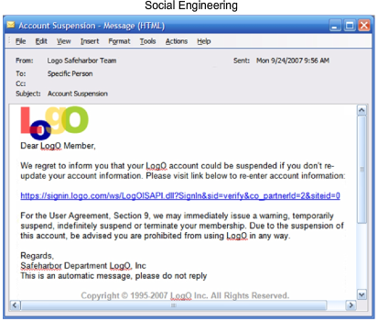
Social Engineering
The easiest hack involves no computer skill.
  If an intruder can trick a member of an organization into giving over information, such as the location of files or passwords, the process of hacking is made much easier.
Phishing is a type of social engineering attack that involves using e-mail in an attempt to trick others into providing sensitive information, such as credit card numbers or passwords.
  Frequently, phishing scams involve sending out spam e-mails that appear to be from known online banking or auction sites.
  These e-mails contain hyperlinks that appear to be legitimate, but actually take users to a fake website set up by the phisher to capture their information.
  Phishing attacks can be prevented by educating users and implementing reporting guidelines when they receive suspicious e-mail.
Notes:
Use graphic 1.1.1.1
Use graphic 1.1.1.3

Slide 12
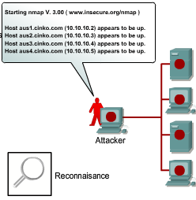
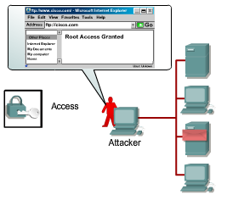
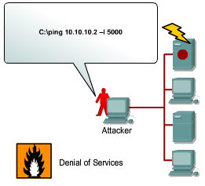
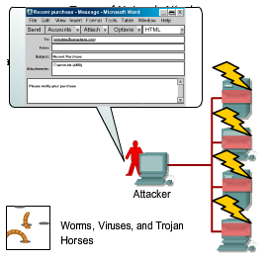
Types of Network Attacks
There are four primary classes of attacks.
Reconnaissance
  Reconnaissance is the unauthorized discovery and mapping of systems, services, or vulnerabilities.
  It is also known as information gathering.
  Reconnaissance is similar to a thief casing a neighborhood for vulnerable homes to break into.
Access
  System access is the ability for an intruder to gain access to a device for which the intruder does not have password.
Denial of Service
  Denial of service (DoS) is when an attacker disables or corrupts networks, systems, with the intent to deny services to intended users.
  For these reasons, DoS attacks are the most feared.
Worms, Viruses, and Trojan Horses
  Malicious software can be inserted onto a host to damage or corrupt a system, replicate itself, or deny access to networks, systems, or services.
Notes:
Use graphic 1.1.1.1
Use graphic 1.1.1.3

Slide 13
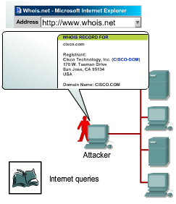
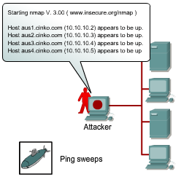
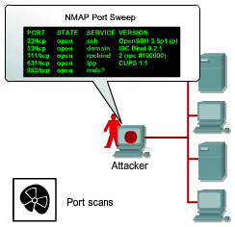
Reconaissance Attacks
Reconnaissance attacks can consist of:
  Internet information queries
    External attackers can use Internet tools, such as the nslookup and whois utilities, to easily determine the IP address space assigned to a given corporation or entity.
  Ping sweeps
    After the IP address space is determined, an attacker can then ping the publicly available IP addresses to identify the addresses that are active.
    An attacker may use a ping sweep tool, such as fping or gping, pings all network addresses in a given subnet.
  Port scans
    When the active IP addresses are identified, the intruder uses a port scanner to determine which network services or ports are active on the live IP addresses.
    A port scanner is software, such as Nmap or Superscan, is designed to search a host for open ports.
    The port scanner queries the ports to determine the application and version, as well as the version of OS.
  Packet sniffers
Notes:
Use graphic 1.1.1.1
Use graphic 1.1.1.3

Slide 14
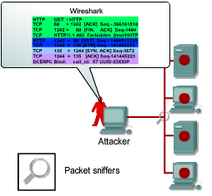
Reconaissance Attacks
Packet sniffers: Internal attackers may attempt to "eavesdrop" on network traffic.
  Two common uses of eavesdropping are as follows:
    Information gathering - Network intruders can identify usernames, passwords, or information carried in a packet.
    Information theft - The network intruder can also steal data from networked computers by gaining unauthorized access.
  A common method for eavesdropping is to capture TCP/IP or other protocol packets and decode the contents.
    An example of such a program is Wireshark.
    It can capture usernames and passwords as they cross network.
  Three of the most effective methods for counteracting eavesdropping are as follows:
    Using switched networks instead of hubs so that traffic is not broadcast to all endpoints or network hosts.
    Using encryption that meets the data security needs without imposing an excessive burden on system resources or users.
    Forbids the use of protocols with known susceptibilities to eavesdropping. SNMP version 3 can encrypt community strings.
Notes:
Use graphic 1.1.1.1
Use graphic 1.1.1.3

Slide 15
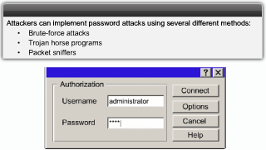
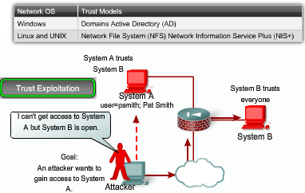
Access Attacks
Access attacks exploit vulnerabilities in authentication, FTP, and web to gain entry to accounts, confidential, and sensitive information.
Password Attacks
  Password attacks usually refer to repeated attempts to log in to a server, to identify a user account, password.
  These repeated attempts are called dictionary attacks or brute-force attacks.
    Password attacks can be mitigated by educating users to use long, complex passwords.
  To conduct a dictionary attack, attackers can use tools such as L0phtCrack or Cain or rainbow tables.
Trust Exploitation
  If a host in a network of a company is protected by a firewall (inside host), but is accessible to a trusted host outside the firewall (outside host), the inside host can be attacked through the trusted outside host.
  For example, private VLANs can be deployed in public-service segments where multiple public servers are available.
Notes:
Use graphic 1.1.1.1
Use graphic 1.1.1.3

Slide 16
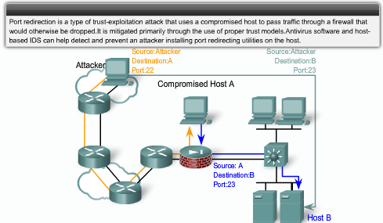
Access Attacks
Port Redirection
  A port redirection is a type of trust exploitation attack that uses a compromised host to pass traffic through a firewall.
  An utility that can provide this type of access is netcat.
  Port redirection can be mitigated through the use a host-based intrusion detection system (IDS).
Notes:
Use graphic 1.1.1.1
Use graphic 1.1.1.3

Slide 17
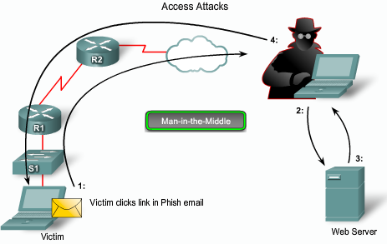
Access Attacks
Man-in-the-Middle Attack
  A man-in-the-middle (MITM) attack is carried out by attackers that position themselves between two hosts.
  An attacker may catch a victim with a phishing e-mail or by defacing a website. For instance http:www.legitimate.com becomes http:www.attacker.com/http://www.legitimate.com.
    1. When a victim requests a webpage, the host of the victim makes the request to the host of the attacker's.
    2. The attacker's host receives the request and fetches the real page from the legitimate website.
    3. The attacker can alter the legitimate webpage and apply any transformations to the data they want to make.
    4. The attacker forwards the requested to the victim.
  WAN MITM attack mitigation is achieved using VPN.
  LAN MITM attacks use tools ettercap and ARP poisoning.
    It can be mitigated by using port security on LAN switches.
Notes:
Use graphic 1.1.1.1
Use graphic 1.1.1.3

Slide 18
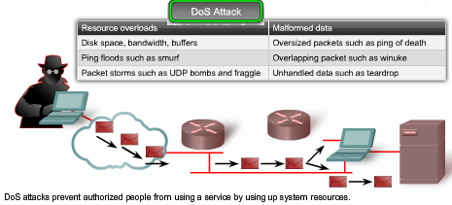
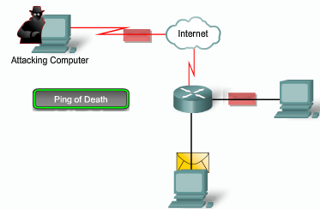
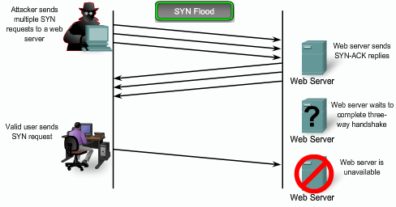
DoS Attacks
DoS attacks are the most publicized form of attack and also among the most difficult to eliminate.
  DoS attacks prevent authorized people from using a service by consuming system resources.
Ping of Death
  A ping is normally 64 (84 bytes with the header).
  The IP packet size could be up to 65,535 bytes.
  A ping of this size may crash an older computer.
SYN Flood
  A SYN flood attack exploits the TCP 3-way handshake.
    It sending multiple SYN requests to a targeted server.
    The server replies with SYN-ACK, but the malicious host never responds the ACK to complete the handshake.
    This ties up the server until it runs out of resources.
E-mail bombs
  Programs send bulk e-mails monopolizing services.
Malicious applets
  These attacks are Java, JavaScript, or ActiveX that cause destruction or tie up computer resources.
Notes:
Use graphic 1.1.1.1
Use graphic 1.1.1.3

Slide 19
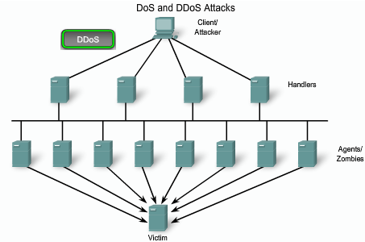
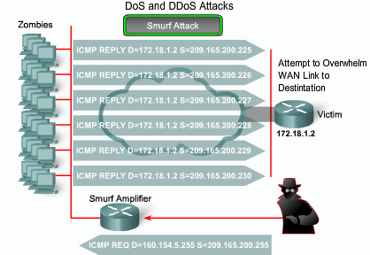
DDoS Attacks
Distributed DoS (DDoS) attacks are designed to saturate network links with illegitimate data.
  Typically, there are 3 components to a DDoS attack.
    A Client who is typically a person who launches the attack.
    A Handler is a compromised host that control multiple Agents
    An Agent is a compromised host that responsible for generating packets that toward the intended victim
Examples of DDoS attacks include the following:
  SMURF attack
  Tribe flood network (TFN)
  Stacheldraht
  MyDoom
The Smurf attack uses spoofed broadcast ping messages to flood a target system. It starts with an attacker sending a large number of ICMP echo requests to the network broadcast address from valid spoofed source IP addresses.
  Turning off directed broadcast capability prevents the network from being used as a bounce site.
Notes:
Use graphic 1.1.1.1
Use graphic 1.1.1.3

Slide 20
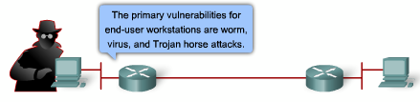
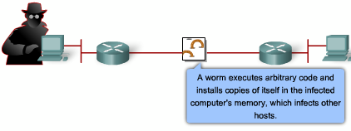
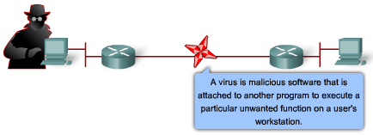
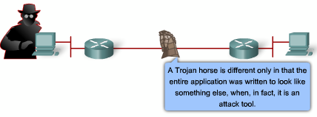
Malicious Code Attacks
The primary vulnerabilities for end-user workstations are worm, virus, and Trojan horse attacks.
  A worm executes code and installs copies of itself in the infected computer, which can infect other hosts.
    A worm installs itself by exploiting known vulnerabilities in systems, such as naive end users who open unverified executable attachments in e-mails
  A virus is malicious software that is attached to another program for the purpose of executing a particular unwanted function on a workstation.
    An example is a program that is attached to command.com and deletes files and infects any other versions of command.com.
  A Trojan horse is that the entire application was written to look like something else, when in fact it is an attack tool.
    Example of a Trojan horse is a software that runs a game. While the user is occupied with the game, the Trojan horse mails a copy of itself to every address in the user's address book.
These kinds of applications can be contained through the effective use of antivirus software at the user level, and potentially at the network level.
Notes:
Use graphic 1.1.1.1
Use graphic 1.1.1.3

Slide 21
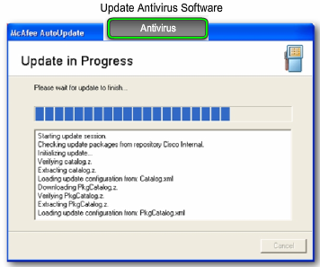
Host and Server Based Security: Device Hardening
When a new operating system is installed on a computer, the level of security is inadequate. There are some simple steps that should be taken :
  Default usernames and passwords should be changed.
  Access to system resources should be restricted to only the individuals that are authorized.
  Any unnecessary services should be turned off.
Additional steps can be taken to secure hosts: Antivirus, firewall, and intrusion detection tools.
Antivirus Software
  Antivirus software to protect against known viruses. Antivirus software does this in two ways:
    It scans files, comparing their contents to known viruses in a virus dictionary. Matches are flagged in a manner defined by the end user.
    It monitors suspicious processes running on a host that might indicate infection.
Notes:
Use graphic 1.1.1.1
Use graphic 1.1.1.3

Slide 22
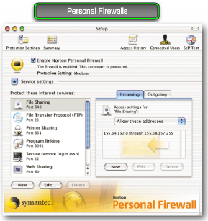
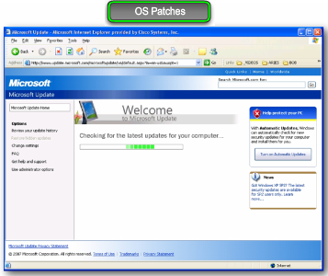
Host and Server Based Security: Device Hardening
Personal Firewall
  Personal computers connected to the Internet through a dialup, DSL, or cable modems are vulnerable.
    Personal firewalls on the PC can prevent attacks.
    Some personal firewall software vendors include McAfee, Norton, Symantec, and Zone Labs.
Operating System Patches
  The most effective way to mitigate a worm and its variants is to download security updates and patch all vulnerable systems.
  This is difficult with uncontrolled systems in the local network, and even more troublesome if these systems are remotely connected via a VPN.
  One solution to the management of security patches is to create a central patch server that all systems must communicate.
    Any patches that are not applied to a host are automatically downloaded from the patch server and installed without user intervention.
Notes:
Use graphic 1.1.1.1
Use graphic 1.1.1.3

Slide 23
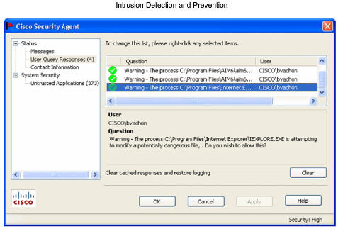
Host and Server Based Security: Device Hardening
Intrusion Detection and Prevention
  Intrusion detection systems (IDS) detect attacks and send logs to a management console.
  Intrusion prevention systems (IPS) prevent attacks. It provides the following active defense:
    Prevention - Stops the detected attack from executing.
    Reaction - Immunizes the system from future attacks.
  Either technology can be implemented at a network or host level, or both for maximum protection.
Host-based Intrusion Detection Systems (HIDS)
  Host-based intrusion is passive technology.
    HIDS sends logs to a management console after the attack has occurred and the damage is done.
Host-based intrusion prevention system (HIPS),
  HIPS stops the attack, and prevents damage.
  Cisco provides HIPS using the Security Agent software.
  Agents are installed on publicly accessible servers and corporate mail and application servers.
Notes:
Use graphic 1.1.1.1
Use graphic 1.1.1.3

Slide 24
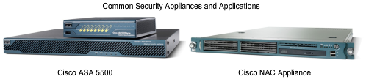
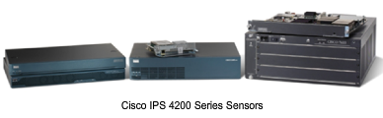
Common Security Appliances and Applications
Network-based intrusion prevention system (HIPS)
A firewall by itself is no longer adequate.
  An integrated approach involving firewall, intrusion prevention, and VPN is necessary.
An integrated approach follows these building blocks:
  Threat control - Regulates network access, prevents intrusions, by counteracting malicious traffic.
    Cisco ASA 5500 Series Adaptive Security Appliances
    Integrated Services Routers (ISR)
    Network Admission Control
    Cisco Security Agent for Desktops
    Cisco Intrusion Prevention Systems
  Secure communications - Secures network endpoints with VPN.
    Cisco ISR routers with Cisco IOS VPN solution,
    Cisco 5500 ASA
    Cisco Catalyst 6500 switches.
  Network admission control (NAC) - Provides a roles-based method of preventing unauthorized access
Notes:
Use graphic 1.1.1.1
Use graphic 1.1.1.3

Slide 25
Common Security Appliances and Applications
Cisco IOS Software on Cisco Integrated Services Routers (ISRs)
  Cisco provides many of the required security measures for customers within the Cisco IOS software. Cisco IOS software provides built-in Cisco IOS Firewall, IPsec, SSL VPN, and IPS services.
Cisco ASA 5500 Series Adaptive Security Appliance
  At one time, the PIX firewall was the one device that a secure network would deploy. The PIX has evolved into a platform that integrates many different security features, called the Cisco Adaptive Security Appliance (ASA). The Cisco ASA integrates firewall, voice security, SSL and IPsec VPN, and IPS in one device.
Cisco IPS 4200 Series Sensors
  For larger networks, an inline intrusion prevention system is provided by the Cisco IPS 4200 series sensors. This sensor identifies, classifies, and stops malicious traffic on the network.
Cisco NAC Appliance
  The Cisco NAC appliance uses the network infrastructure to enforce security policy compliance on all devices seeking to access network computing resources.
Cisco Security Agent (CSA)
  Cisco Security Agent software provides threat protection capabilities for server, desktop, and point-of-service (POS) computing systems.
Notes:
Use graphic 1.1.1.1
Use graphic 1.1.1.3

Slide 26
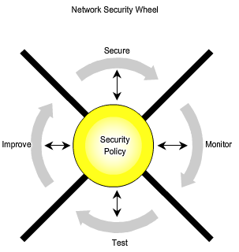
The Network Security Wheel
Most security incidents occur because system administrators do not implement available countermeasures, and attackers or disgruntled employees exploit the oversight.
To assist with the compliance of a security policy, the Security Wheel, a continuous process, has proven to be an effective approach.
  The Security Wheel promotes retesting and reapplying updated security measures on a continuous basis.
To begin the Security Wheel process, first develop a security policy that enables the application of security measures. A security policy includes the following:
  Identifies the security objectives of the organization.
  Documents the resources to be protected.
  Identifies the network infrastructure with current maps and inventories.
  Identifies the critical resources that need to be protected.
    This is called a risk analysis.
Notes:
Use graphic 1.1.1.1
Use graphic 1.1.1.3

Slide 27
The Network Security Wheel
The security policy is the four steps of Security Wheel.
Step 1: Secure
  Secure the network by applying the security policy and implementing the following security solutions:
    Threat defense
    Stateful inspection and packet filtering
Step 2: Monitor
  Monitoring security involves both active and passive methods of detecting security violations.
    The active method is to audit host-level log files.
    Passive methods include using IDS devices to detect intrusion.
Step 3: Test
  The functionality of the security solutions implemented in step 1 and the system auditing and intrusion detection methods implemented in step 2 are verified.
Step 4: Improve
  With the information collected from the monitoring and testing phases, IDSs can be used to implement improvements
Notes:
Use graphic 1.1.1.1
Use graphic 1.1.1.3

Slide 28

The Enterprise Security Policy
What is a Security Policy?
  A security policy is a set of guidelines established to safeguard the network from attacks, both from inside and outside a company.
A security policy benefits an organization in the following ways:
  Provides a means to audit existing network security and compare the requirements to what is in place.
  Plan security improvements, including equipment, software, and procedures.
  Defines the roles and responsibilities of the company executives, administrators, and users.
  Defines which behavior is and is not allowed.
  Defines a process for handling network security incidents.
  Creates a basis for legal action if necessary.
A security policy is a living document, meaning that the document is never finished and is continuously updated as technology and employee requirements change.
Notes:
Use graphic 1.1.1.1
Use graphic 1.1.1.3

Slide 29

Functions of a Security Policy
A comprehensive security policy:
  Protects people and information
  Sets the rules for expected behavior by users, system administrators, management, and security personnel
  Authorizes security personnel to monitor, probe, and investigate
  Defines and authorizes the consequences of violations
The security policy is for everyone, including employees, contractors, suppliers, and customers who have access to the network.
  However, the security policy should treat each of these groups differently.
  Each group should only be shown the portion of the policy appropriate to their work and level of access to the network.
  One document is not likely to meet the needs of the entire audience in a large organization.
Notes:
Use graphic 1.1.1.1
Use graphic 1.1.1.3

Slide 30
Components of a Security Policy (1 of 3)
The SANS Institute (http://www.sans.org) provides guidelines for developing comprehensive security policies for organizations large and small.
  Not all organizations need all of these policies.
The following are general security policies that an organization may invoke:
  Statement of authority and scope - Defines who in the organization sponsors the security policy, who is responsible for implementing it, and what areas are covered.
  Acceptable use policy (AUP) - Defines the acceptable use of equipment and computing services, and the appropriate employee security measures to protect the organization corporate resources and proprietary information.
  Identification and authentication policy - Defines which technologies the company uses to ensure that only authorized personnel have access to its data.
  Internet access policy - Defines what the company will and will not tolerate with respect to the use of its Internet connectivity by employees and guests.
  Campus access policy - Defines acceptable use of campus technology resources by employees and guests.
  Remote access policy - Defines how remote users can use the remote access infrastructure of the company.
  Incident handling procedure - Specifies who will respond to security incidents, and how they are to be handled.
Notes:
Use graphic 1.1.1.1
Use graphic 1.1.1.3

Slide 31
Components of a Security Policy (2 of 3)
In addition to these key security policy sections, some others that may be necessary in certain organizations include:
  Account access request policy - Formalizes the account and access request process within the organization. Users and system administrators who bypass the standard processes for account and access requests can lead to legal action against the organization.
  Acquisition assessment policy - Defines the responsibilities regarding corporate acquisitions and defines the minimum requirements of an acquisition assessment that the information security group must complete.
  Audit policy - Defines audit policies to ensure the integrity of information and resources. This includes a process to investigate incidents, ensure conformance to security policies, and monitor user and system activity where appropriate
  Information sensitivity policy - Defines the requirements for classifying and securing information in a manner appropriate to its sensitivity level.
  Password policy - Defines the standards for creating, protecting, and changing strong passwords.
  Risk assessment policy - Defines the requirements and provides the authority for the information security team to identify, assess, and remediate risks to the information infrastructure associated with conducting business.
  Global web server policy - Defines the standards required by all web hosts.
Notes:
Use graphic 1.1.1.1
Use graphic 1.1.1.3

Slide 32
Components of a Security Policy (3 of 3)
With the extensive use of e-mail, an organization may also want to have policies specifically related to e-mail, such as:
  Automatically forwarded e-mail policy - Documents the policy restricting automatic e-mail forwarding to an external destination without prior approval from the appropriate manager or director.
  E-mail policy - Defines content standards to prevent tarnishing the public image of the organization.
  Spam policy - Defines how spam should be reported and treated.
Remote access policies might include:
  Dial-in access policy - Defines the appropriate dial-in access and its use by authorized personnel.
  Remote access policy - Defines the standards for connecting to the organization network from any host or network external to the organization.
  VPN security policy - Defines the requirements for VPN connections to the network of the organization.
It should be noted that users who defy or violate the rules in a security policy may be subject to disciplinary action, up to and including termination of employment.
Notes:
Use graphic 1.1.1.1
Use graphic 1.1.1.3

Slide 33
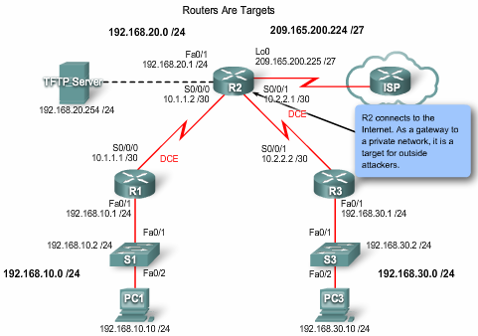
Routers are Targets
Because routers provide gateways to other networks, they are obvious targets. Here are some examples of various security problems:
  Compromising the access control can expose network configuration details, thereby facilitating attacks against other network components.
  Compromising the route tables can reduce performance, deny network communication services, and expose sensitive data.
  Misconfiguring a router traffic filter can expose internal network components to scans and attacks, making it easier for attackers to avoid detection.
Attackers can compromise routers in different ways.
  The types of attacks including trust exploitation attacks, IP spoofing, session hijacking, and MITM attacks.
Note: This section focuses on securing routers. Most of the best practices discussed can also be used to secure switches.
Notes:
Use graphic 1.1.1.1
Use graphic 1.1.1.3

Slide 34
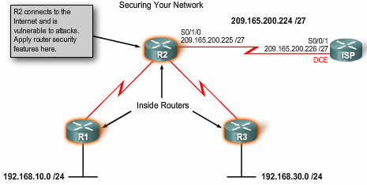
Router Security Issues
Physical security
  Locate the router in a locked room that is accessible only to authorized personnel.
  To reduce the possibility of DoS due to a power failure, install an uninterruptible power supply (UPS).
Update the router IOS whenever advisable
  However, the latest version of an operating system may not be the most stable version available.
  To get the best security performance from your operating system, use the latest stable release that meets the feature requirements of your network.
Backup the router configuration and IOS
  Keep a secure copy of the router image and router configuration file on a TFTP server for backup purposes.
Harden the router to eliminate the potential abuse of unused ports and services
  A router has many services enabled by default.
  You should harden your router configuration by disabling unnecessary services.
Notes:
Use graphic 1.1.1.1
Use graphic 1.1.1.3

Slide 35
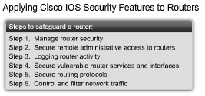
Applying Cisco IOS Security Features to Routers
Before you configure security features on a router, you need a plan for all the Cisco IOS security configuration steps.
  The first 5 steps are discussed in this chapter.
  Though access control lists (ACLs) are discussed in the next chapter, they are a critical technology and must be configured to control and filter network traffic.
Notes:
Use graphic 1.1.1.1
Use graphic 1.1.1.3

Slide 36

Step 1: Manage Router Security
Basic router security consists of configuring passwords.
Good password practices include the following:
  Do not write passwords down and leave them in places such as your desk or on your monitor.
  Avoid dictionary words, names, phone numbers, and dates.
  Combine letters, numbers, and symbols. Include at least one lowercase letter, uppercase letter, digit, and special character.
  Deliberately misspell a password. For example, Smith can be spelled as 5mYth. Another example could be Security spelled as 5ecur1ty.
  Make passwords lengthy. The best practice is to have a minimum of eight characters.
  Change passwords as often as possible. This practice limits the window of opportunity in which a hacker can crack a password and limits the window of exposure after a password has been compromised.
Passphrases
  A recommended method for creating strong complex passwords is to use passphrases. A passphrase is basically a sentence or phrase that serves as a more secure password.
Notes:
Use graphic 1.1.1.1
Use graphic 1.1.1.3

Slide 37
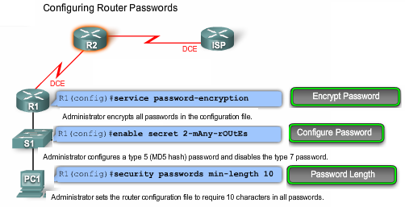
Step 1: Manage Router Security
By default, Cisco IOS software leaves passwords in plain text when they are entered on a router. This is not secure since anyone walking behind you when you are looking at a router configuration could snoop over your shoulder and see the password.
Using the enable password command or the username username password password command would result in these passwords being displayed when looking at the running configuration.
  For example:
  R1(config)# username Student password cisco123
  R1(config)# do show run | include username
      username Student password 0 cisco123
  R1(config)#
    The 0 displayed in the running configuration, indicates that password is not hidden.
Notes:
Use graphic 1.1.1.1
Use graphic 1.1.1.3

Slide 38
Step 1: Manage Router Security
Cisco IOS provides 2 password protection schemes:
  Simple encryption called a type 7 scheme.
    It hide the password using a simple encryption algorithm.
    use the service password-encryption global command.
    The type 7 encryption can be used by enable password, and line password including vty, line console, and aux port.
    R1(config)# service password-encryption
    R1(config)# do show run | include username
        username Student password 7 03075218050061
    R1(config)#
  Complex encryption called a type 5 scheme.
    It uses a more secure MD5 hash.
    To protect the privileged EXEC level use enable secret command.
      Router will use the secret password over the enable password.
    The local database usernames should be also configured using the username username secret password command.
    R1(config)# username Student secret cisco
    R1(config)# do show run | include username
      username Student secret 5 $1$z245$lVSTJzuYgdQDJiacwP2Tv/
    R1(config)#
Notes:
Use graphic 1.1.1.1
Use graphic 1.1.1.3

Slide 39
Step 1: Manage Router Security
Password Length
  Cisco IOS Software Release 12.3(1) and later allow administrators to set the minimum character length for all router passwords using the security passwords min-length global configuration command
    This eliminating common passwords that are prevalent on most networks, such as "lab" and "cisco."
    This command affects any new user passwords, enable passwords and secrets, and line passwords created after the command was executed.
    The command does not affect existing router passwords.
Notes:
Use graphic 1.1.1.1
Use graphic 1.1.1.3

Slide 40

Step 2: Securing Remote Administrative Access To Routers
Local access through the console port is the preferred way for an administrator to connect to a device to manage it because it is secure.
  As companies get bigger and the number of routers and switches in the network grows, to connect to all the devices locally can become overwhelming.
Remote administrative access is more convenient than local access.
  However, remote administrative access using Telnet can be very insecure because Telnet forwards all network traffic in clear text.
  An attacker could capture network traffic and sniff the administrator passwords or router configuration.
To secure administrative access to routers and switches,
  first secure the administrative lines (VTY, AUX),
  then configure the network device to encrypt traffic in an SSH tunnel.
?
Notes:
Use graphic 1.1.1.1
Use graphic 1.1.1.3

Slide 41

Step 2: Securing Remote Administrative Access To Routers
Remote access typically involves allowing Telnet, Secure Shell (SSH), HTTP, HTTP Secure (HTTPS), or SNMP connections to the router from a computer.
If remote access is required, your options are:
  Establish a dedicated management network.
    This could be accomplished using a management VLAN or by using an additional physical network.
  Encrypt all traffic between the administrator computer and the router.
    In either case, a packet filter can be configured to only allow the identified hosts and protocol to access the router.
    For example, only permit the administration host IP address to initiate an SSH connection to the routers in the network.
Notes:
Use graphic 1.1.1.1
Use graphic 1.1.1.3

Slide 42


Step 2: Securing Remote Administrative Access To Routers
Remote access not only applies to the VTY line of the router, it also applies to the TTY lines and AUX port.
  Logins may be prevented on any line by configuring the router with the login and no password commands.
Controlling VTYs
  By default, all VTY lines are configured to accept any type of remote connection.
  For security reasons, VTY lines should be configured to accept connections only with the protocols actually needed.
    This is done with the transport input command.
      A VTY that was expected to receive only Telnet sessions would be configured with transport input telnet,
      A VTY permitting both Telnet and SSH sessions would have transport input telnet ssh configured.
Notes:
Use graphic 1.1.1.1
Use graphic 1.1.1.3

Slide 43

Step 2: Securing Remote Administrative Access To Routers
A Cisco device has a limited VTY lines, usually five.
  When all of the VTYs are in use, no more additional remote connections can be established.
  This creates the opportunity for a DoS attack.
  The attacker does not have to log in to do this. The sessions can simply be left at the login prompt.
One way of reducing this exposure is to configure the last VTY line to accept connections only from a single, specific administrative workstation,
To implement this, ACLs, along with the ip access-class command on the last VTY line, must be configured.
  This implementation is discussed in Chapter 5.
Another useful tactic is to configure VTY timeouts using the exec-timeout command.
  it provides protection against sessions accidentally left idle.
  Similarly, enabling TCP keepalives on incoming connections using the service tcp-keepalives-in command can help guard against both malicious attacks and orphaned sessions caused by remote system crashes.
Notes:
Use graphic 1.1.1.1
Use graphic 1.1.1.3

Slide 44

Step 2: Securing Remote Administrative Access To Routers
Traditionally, remote administrative access on routers was configured using Telnet on TCP port 23.
  All Telnet traffic is forwarded in plain text.
SSH has replaced Telnet for providing remote access with connections that support privacy and integrity.
  SSH uses port TCP 22.
  Not all Cisco IOS images support SSH.
  Only cryptographic images can.
Cisco routers are capable of acting as the SSH client and server.
  By default, both of these functions are enabled on the router when SSH is enabled.
    As a client, a router can SSH to another router.
    As a server, a router can accept SSH client connections.
Notes:
Use graphic 1.1.1.1
Use graphic 1.1.1.3

Slide 45






Configuring SSH Security
To enable SSH, the following parameters must be configured:
  1. Hostname 2. Domain name
  3. Asymmetrical keys 4. Local authentication
Optional configuration parameters include:
  Timeouts -Retries
Step 1: Set router parameters
  Configure the router hostname with the hostname command.
Step 2: Set the domain name
  Enter the ip domain-name cisco.com command.
Step 3: Generate asymmetric keys
  You need to create a key that the router uses to encrypt its SSH management traffic with the crypto key generate rsa command.
  Cisco recommends using a minimum modulus length of 1024.
Step 4: Configure local authentication and vty
  You must define a local user and assign SSH to the vty lines.
Step 5: Configure SSH timeouts (optional)
  Use the command ip ssh time-out second and authentication-retries integer to enable timeouts and authentication retries.
  Set the SSH timeout to 15 seconds and the amount of retries to 2
Notes:
Use graphic 1.1.1.1
Use graphic 1.1.1.3

Slide 46

Test SSH Security
To connect to a router configured with SSH, you have to use an SSH client application such as PuTTY or TeraTerm.
You must be sure to choose the SSH option and that it uses TCP port 22.
  Using TeraTerm to connect securely to the R2 router with SSH,
  once the connection is initiated, the R2 displays a username prompt, followed by a password prompt.
  Assuming that the correct credentials are provided, TeraTerm displays the router R2 user EXEC prompt.
Notes:
Use graphic 1.1.1.1
Use graphic 1.1.1.3

Slide 47



Step 2: Securing Remote Administrative Access To Routers: Activity
Change: crypto key generate isa to crypto key generate rsa Change ip shh time-out 15 to ip ssh timeout 15
Notes:
Use graphic 1.1.1.1
Use graphic 1.1.1.3

Slide 48

Step 3: Logging Router Activity
Logs allow you to verify router is working properly.
  Routers support 8 levels of logging.
  The 8 levels range from 0, emergencies indicating that the system is unstable, to 7 for debugging messages.
  The most important thing to remember about logging is that logs must be reviewed regularly.
Logs can be forwarded to a variety of locations,
  Router memory
  Syslog server.
    A syslog server provides a better solution because all network devices can forward their logs to one central station where an administrator can review them.
    An example of a syslog server is Kiwi Syslog Daemon.
Accurate time stamps are important to logging.
  R2(config)#service timestamps ?
  debug Timestamp debug messages
  log Timestamp log messages
  <cr>
  R2(config)#service timestamps
There are eight different logging levels.
  0—emergencies
  1—alerts
  2—critical
  3—errors
  4—warnings
  5—notification
  6—informational
  7—debugging
Notes:
Use graphic 1.1.1.1
Use graphic 1.1.1.3

Slide 49

Step 4: Vulnerable Router Services and Interfaces
Cisco routers support a large number of network services at layers 2, 3, 4, and 7.
  Some of these services are application layer protocols.
  Others are automatic processes and settings intended to support legacy configurations that pose security risks.
Some of these services can be restricted or disabled to improve security without degrading the operational use of the router.
  Most of the services listed in this section are usually not required.
Note: CDP is leveraged in some IP Phone implementations. This needs to be considered before broadly disabling the service.
Notes:
Use graphic 1.1.1.1
Use graphic 1.1.1.3

Slide 50

Step 4: Vulnerable Router Services and Interfaces
Services which should typically be disabled are.
  Cisco Discovery Protocol (CDP) - Use the no cdp run.
  Source routing - Use the no ip source-route command.
  Classless routing - Use the no ip classless command.
  Small services such as echo, discard, and chargen - Use the no service tcp-small-servers or no service udp-small-servers command.
  Finger - Use the no service finger command.
  BOOTP - Use the no ip bootp server command.
  HTTP - Use the no ip http server command.
  Remote configuration - Use the no service config.
  SNMP - Use the no snmp-server command.
The interfaces on the router can be made more secure by using certain commands in interface configuration mode:
  Unused interfaces - Use the shutdown command.
  Ad hoc routing - Use the no ip proxy-arp command.
  No SMURF attacks - Use the no ip directed-broadcast.
Notes:
Use graphic 1.1.1.1
Use graphic 1.1.1.3

Slide 51

Step 4: Vulnerable Router Services and Interfaces
SNMP
  SNMP is the Internet protocol for automated remote monitoring and administration.
  Versions of SNMP prior to version 3 shuttle information in clear text.
NTP
  Cisco routers and other hosts use NTP to keep their time-of-day clocks accurate.
  If an NTP hierarchy is not available on the network, you should disable NTP.
  Disabling NTP on an interface does not prevent NTP messages from traversing the router. To reject all NTP messages at a particular interface, use an access list.
DNS
  Cisco IOS software supports looking up hostnames with the DNS.
  Unfortunately, the basic DNS protocol offers no authentication or integrity assurance. By default, name queries are sent to the broadcast address 255.255.255.255.
  If one or more name servers are available on the network, and it is desirable to use names in Cisco IOS commands, explicitly set the name server addresses using the global configuration command ip name-server addresses. Otherwise, turn off DNS name resolution with the command no ip domain-lookup.
Notes:
Use graphic 1.1.1.1
Use graphic 1.1.1.3

Slide 52


Step 5: Securing Routing Protocols
Routing systems can be attacked in 2 ways:
  Disruption of peers
    Disruption of peers is the less critical of the two attacks because routing protocols heal themselves.
  Falsification of routing information
    Falsified routing information may generally be used to cause systems to misinform (lie to) each other, cause a DoS, or cause traffic to follow a path it would not normally follow.
    The consequences of falsifying routing information are:
      1. Redirect traffic to create routing loops
      2. Redirect traffic so it can be monitored on an insecure link
      3. Redirect traffic to discard it
Notes:
Use graphic 1.1.1.1
Use graphic 1.1.1.3

Slide 53
Step 5: Securing Routing Protocols
A way to attack the routing system is to attack the routers running the routing protocols and inject false information.
  For example: The attacker injects false routing information destined to router R1 only, indicating that R3 is the preferred destination to the 192.168.10.10/32 host route.
  Although R1 has a routing table entry to the directly connected 192.168.10.0/24 network, it will add the injected route to its routing table because of the longer subnet mask.
  When PC3 sends a packet to PC1 (192.168.10.10), R1 will not forward the packet to the PC1 host. Instead it will route the packet to router R3, because, as far as it is concerned, the best path to 192.168.10.10/32 is through R3. When R3 gets the packet, it will look in its routing table and forward the packet back to R1, which creates the loop.
Notes:
Use graphic 1.1.1.1
Use graphic 1.1.1.3

Slide 54

Step 5: Securing Routing Protocols
The best way to protect routing information on the network is to authenticate routing packets using MD5.
  An algorithm like MD5 allows the routers to compare signatures that should all be the same.
  The three components of such a system include:
    1. Encryption algorithm, which is public knowledge
    2. Key used in the encryption algorithm, which is a secret shared by the routers authenticating their packets
    3. Contents of the packet itself
Generally, the originator of the routing information produces a signature using the key and routing data it is about to send as inputs to the encryption algorithm.
  The routers receiving this routing data can then repeat the process using the same key, the data it has received, and the same routing data.
  If the signature the receiver computes is the same as the signature the sender computes, the update is authenticated.
RIPv2, EIGRP, OSPF, IS-IS, and BGP all support various forms of MD5 authentication.
Notes:
Use graphic 1.1.1.1
Use graphic 1.1.1.3

Slide 55


Step 5: Securing Routing Protocols
RIPv2 with Routing Protocol Authentication
  To secure routing updates each router must be configured to support authentication.
The steps to secure RIPv2 updates are as follows:
  Step 1. Prevent RIP routing update propagation
  Step 2. Prevent unauthorized reception of RIP updates
  Step 3. Verify the operation of RIP routing
Step 1. Prevent RIP Routing Update Propagation
  You need to prevent an intruder listening on the network from receiving updates.
    You do this by forcing all interfaces on the router into passive mode, and then bringing up only those interfaces that are required for sending and receiving RIP updates.
    An interface in passive mode receives updates but does not send updates.
  The passive-interface default command disables routing advertisements on all interfaces.
  The no passive-interface s0/0/0 command enables the S0/0/0 interface to send and receive RIP updates.
Notes:
Use graphic 1.1.1.1
Use graphic 1.1.1.3

Slide 56




Step 5: Securing Routing Protocols
Step 2. Prevent Unauthorized Reception of RIP Updates
  The intruder is prevented from intercepting RIP updates because MD5 authentication has been enabled on routers.
  The example commands
    create a key chain named RIP_KEY.
    Key 1 is configured to contain a key string called cisco.
    The key string is similar to a password and routers exchanging authentication keys must configured with the same key string.
    Interface S0/0/0 is configured to support MD5 authentication.
    The RIP_KEY chain and the routing update, are processed using the MD5 algorithm to produce a unique signature.
  Once R1 is configured, the other routers will receive encrypted routing updates and consequently will no longer be able to decipher the updates from R1. This condition will remain until each router in the network is configured with routing protocol authentication.
Step 3. Verify the Operation of RIP Routing
  Using the show ip route command the output confirms that router R1 has authenticated with the other routers and has been able to acquire the routes from the routers R2 and R3.
Notes:
Use graphic 1.1.1.1
Use graphic 1.1.1.3

Slide 57



Step 5: Securing Routing Protocols
EIGRP
  The steps to configure EIGRP routing protocol authentication on router R1 are as follows:
    Step 1. To create a key chain to be used by all routers in your network.
      Create a key chain named EIGRP_KEY
      Create a key number of 1 and a key string of cisco.
    Step 2. enable MD5 authentication in EIGRP packets traversing an interface.
OSPF
  The figure shows the commands used to configure routing protocol authentication for OSPF on router R1 on interface S0/0/0.
    The first command specifies the key that will be used for MD5 authentication.
    The next command enables MD5 authentication.
Notes:
Use graphic 1.1.1.1
Use graphic 1.1.1.3

Slide 58


Locking Down Router with Cisco Auto Secure
Cisco AutoSecure uses a single command to disable non-essential system processes and services, eliminating potential security threats.
You can configure AutoSecure in privileged EXEC mode using the auto secure command in one of these two modes:
  Interactive mode - This mode prompts you with options to enable and disable services and other security features. This is the default mode.
  Non-interactive mode - This mode automatically executes the auto secure command with the recommended Cisco default settings. This mode is enabled with the no-interact command option.
Cisco AutoSecure will ask you for a number of items:
  Interface specifics
  Banners
  Passwords
  SSH
  IOS firewall features
Tony Chen COD
Cisco Networking Academy
The syntax for this command is as follows:
auto secure [management | forwarding] [no-interact]
Notes:
Use graphic 1.1.1.1
Use graphic 1.1.1.3

